Slide 1
Introduction to Statistical Analysis with R
W. Joel Schneider
Linda Ruan
Brittney Williams

Slide 2

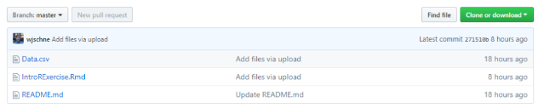
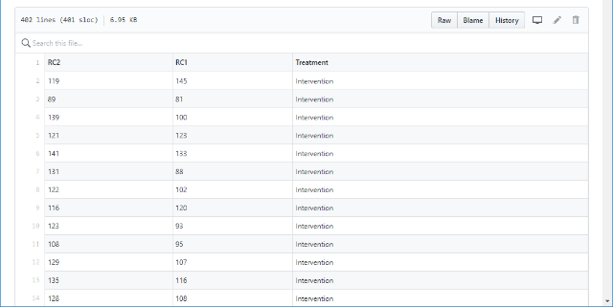
Slides & Supporting Materials
github.com/wjschne/
Click the RWorkshop repository
Click files.
Download files using the Raw button.
Or download everything as a .zip file.

Slide 3
What is R?
A programming language
built for statistics.
Software that runs code
written in the R language.
A free, open-source
ecosystem for data science.
A community of scholars,
analysts, and developers.

Slide 4
What Can You Do With R?
Visualize
Import
Tidy
Transform
Communicate
Model
Understand
Adapted from image in Wickham & Grolemund, 2017

Slide 5
Cool Stuff You Can Do With R

Slide 6
You can import any kind of data, even if it is really messy

Slide 7
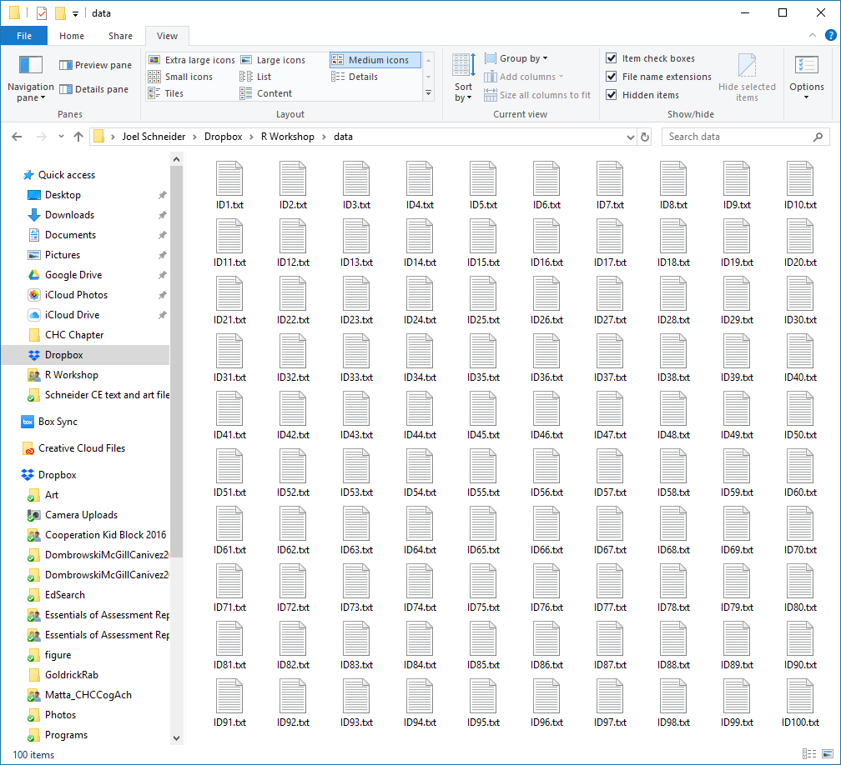
Oh no! My software only exports individual cases as single text files.
Have no fear!
map_df(files, read_tsv)

Slide 8
Straightforward Data Wrangling
library(tidyverse)
# Nested statements are confusing d <- mutate(select(read_csv("data.csv"), CaseID, Length, Width), Area = Length * Width)
# Naming your steps is awful d_import <- read_csv("data.csv") d_selected <- select(d_import, CaseID, Length, Width) d_updated <- mutate(d_selected, Area = Length * Width)
# Piping is gloriously readable.
d <- read_csv("data.csv") %>% select(CaseID, Length, Width) %>% mutate(Area = Length * Width)

Slide 9
Tidy Data/ Tidy Analysis
Age | Reading_1 | Reading_2 | Treatment
5–6 | 89 | 98 | Intervention
5–6 | 69 | 72 | Intervention
10–14 | 45 | 55 | Control
15–18 | 99 | 98 | Control
15–18 | 122 | 133 | Intervention
7–9 | 77 | 80 | Control
10–14 | 93 | 102 | Intervention
… | … | … | …
d %>% group_by(Age) %>% nest() %>% mutate(Model = map(data, function(data) lm(Reading_2 ~ Reading_1 * Treatment, data)), Coefficients = map(Model, tidy), Fit = map(Model, glance))
Age | data | Model | Coefficients | Fit
5–6 | <data subset> | <model> | <coef> | <fit>
7–9 | <data subset> | <model> | <coef> | <fit>
10–14 | <data subset> | <model> | <coef> | <fit>
15–18 | <data subset> | <model> | <coef> | <fit>

Slide 10
Analyses
Bayesian variants of most of these
Meta-Analysis
Regression
Mediation/Moderation
Classical Test Theory
Non-Parametric Statistics
Generalized Linear Models
Item Response Theory
ANOVA
MANOVA
Canonical Correlation Analysis
Correlations
Generalizability Theory
Multilevel Modeling
Factor Analysis
Structural Equation Modeling
Discriminant Function Analysis
Cluster Analysis
Regression Trees
Power Analysis
Correspondence Analysis
Survival Analysis
Multidimensional Scaling
Network Analysis
Time Series

Slide 11
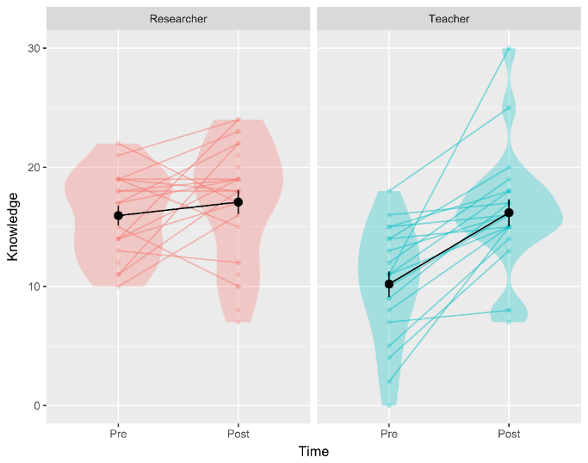
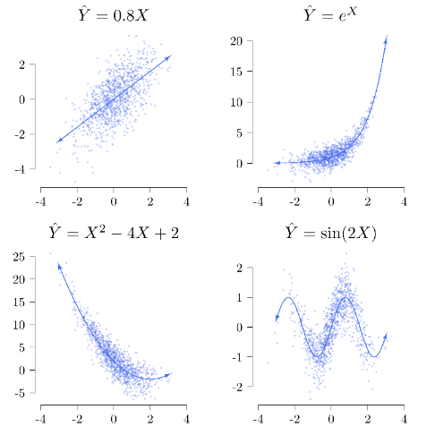
Cool Plots

Slide 12
Document Production
Write your results section in the same document in which your do your analyses!
Output all results in APA style?
Automated reports

Slide 13
Our Task
Install R
Install RStudio
Create a Project File
Create an RMarkdown file
Import Data
Descriptives
Run a regression model
Plot our finding

Slide 14
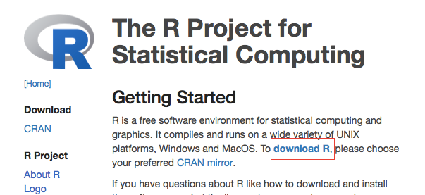
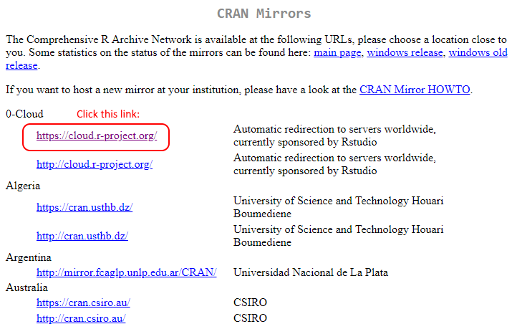
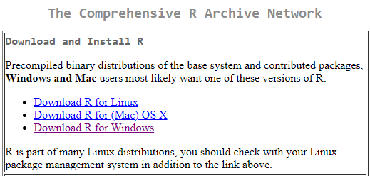
Installing R from r-project.org

Slide 15
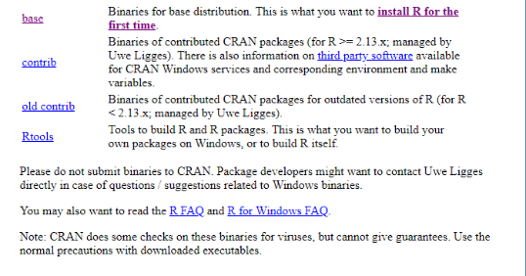
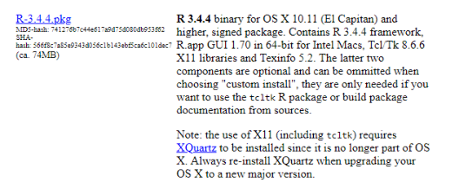
Installing R
Windows
Mac

Slide 16
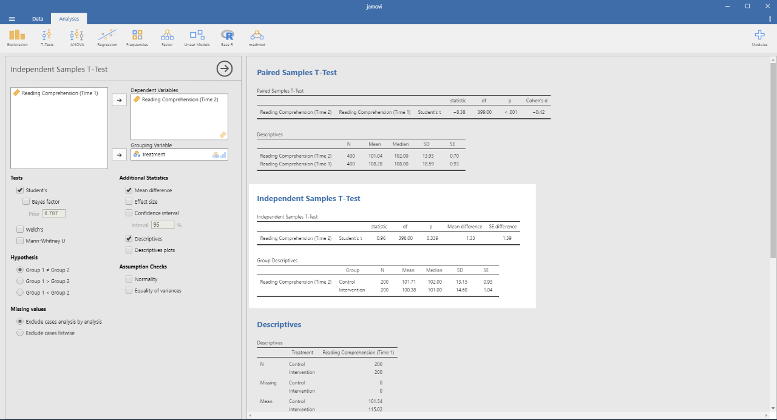
Jamovi

Slide 17


What is RStudio?
A company that makes RStudio
Software that makes the fiddly parts of R not so fiddly
The reason R achieved liftoff

Slide 18

Pick the FREE version of RStudio Desktop

Slide 19
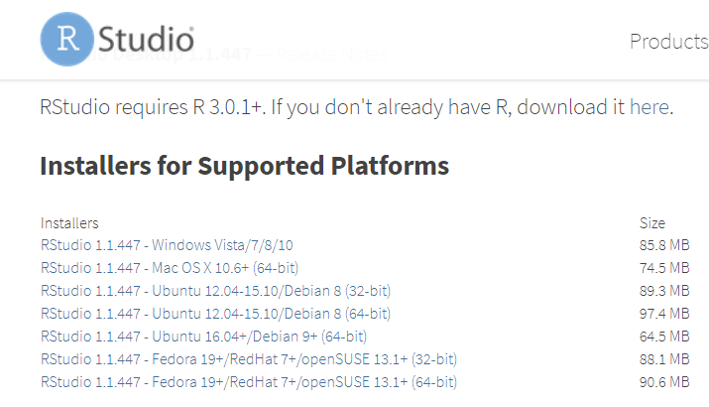
Click the link for your operating system

Slide 20
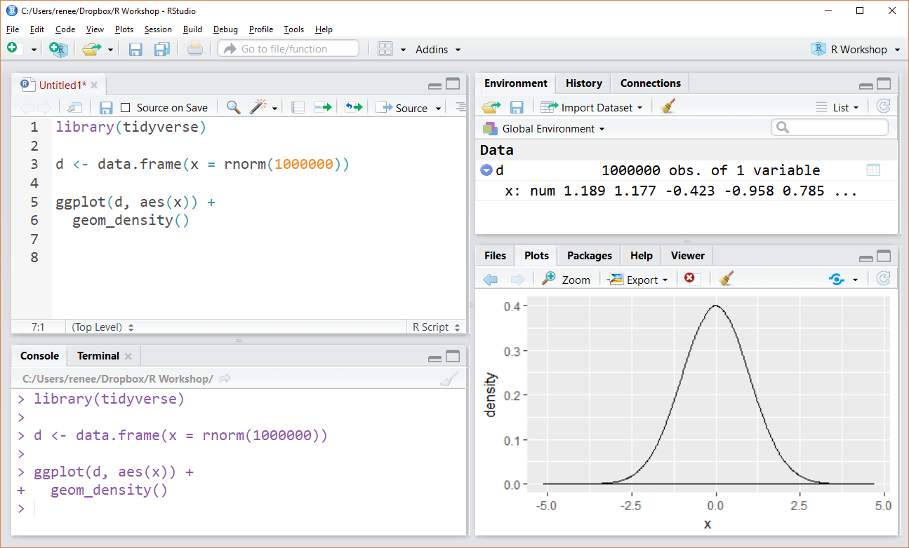
Data & Variables
RStudio
Script File
Plots
Console

Slide 21
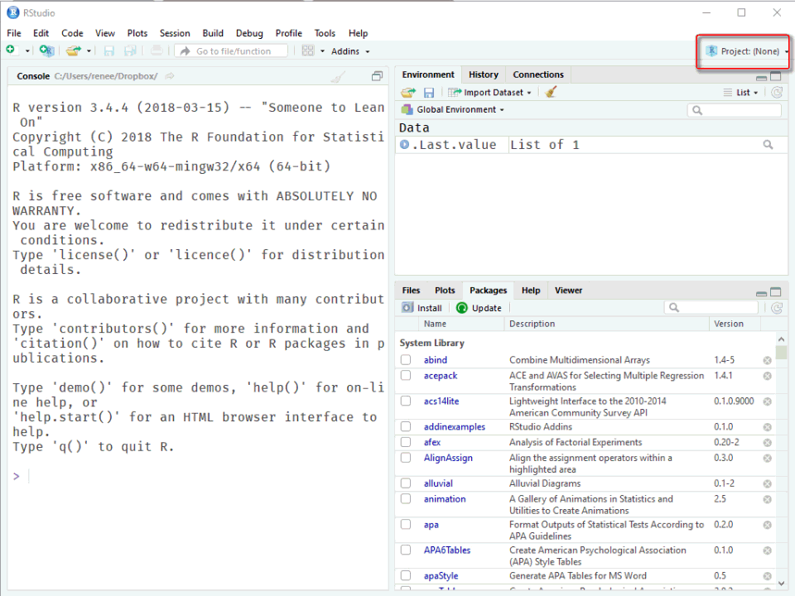
Create a New Project
Create new folder for this workshop course on your computer (e.g., RWorkshop).
Open RStudio.
Create a new project,
Click File → New Project
Select Existing Directory
Click Browse
Navigate to the new folder.
Click Open
Click Create Project

Slide 22
Why Projects Files Are Good
Instead of typing this:
You put your data in the project folder and just type this:
Thus, your code is portable, and others can run it on their machines.
d <- import("C:/Users/Joel/Documents/Courses/RLabs/MyData.csv")
d <- import("MyData.csv")

Slide 23
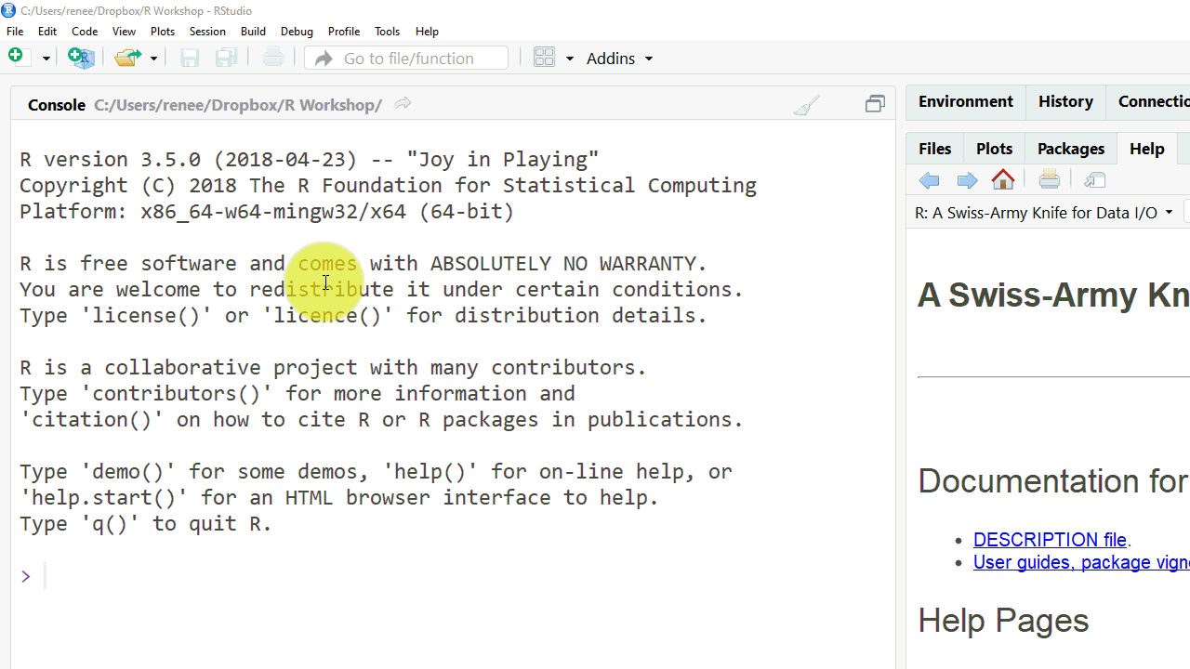
Create an RMarkdown File
File → New File → RMarkdown
Complete Title and Author fields.
Select document format.
Save the file in your project folder.

Slide 24
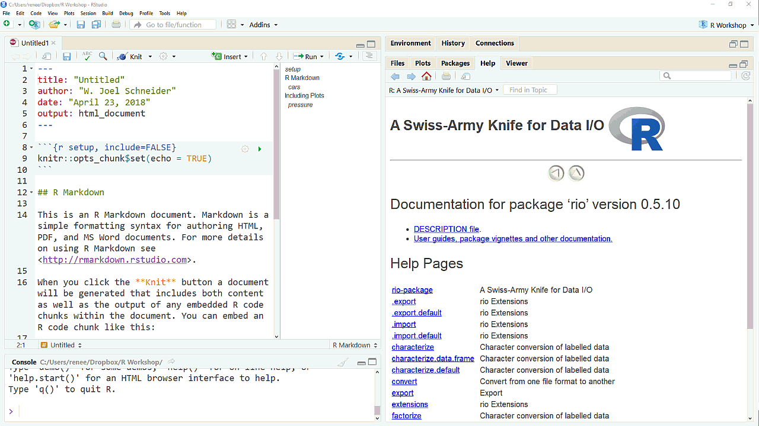
Using Packages
Install once using the Install on the Packages tab.
Load each session using the library command.
Update periodically with the Update button on the Packages tab.
Install the psych, tidyverse, and rio packages now.

Slide 25
Thinking About Data: SPSS vs. R
SPSS | R
The data are stored in an SPSS-specific format | The data are stored in any format (e.g., .csv, .txt, .xlsx, .xml, .html, SPSS, SAS, Stata, and many others).
Data imported from other formats are saved in the .sav format | Data stay where they are, in their pristine state.
You edit your data in SPSS. | You edit your data in your preferred editor (e.g., Excel or even SPSS). After editing, you import the data into R.
The data are before your eyes at all times. | You can see your data whenever you want to, but you will find you do not usually need to.
When you make changes in your data, you save your file or make a new copy of it. | You make your changes in code, and run the code every time you load your data. Saving copies of data is not usually necessary.

Slide 26
Import
d <- import("https://github.com/wjschne/RWorkshop/raw/master/Data.csv")

Slide 27
Descriptive Statistics
#overall Summary summary(d)
## RC2 RC1 Treatment ## Min. : 52.0 Min. : 63.00 Intervention:200 ## 1st Qu.: 95.0 1st Qu.: 90.75 Control :200 ## Median :108.0 Median :102.00 ## Mean :108.3 Mean :101.04 ## 3rd Qu.:121.0 3rd Qu.:110.00 ## Max. :152.0 Max. :145.00
# More complete descriptives (from psych package) describe(d)
## vars n mean sd median trimmed mad min max range skew ## RC2 1 400 108.28 18.59 108.0 108.42 19.27 52 152 100 -0.12 ## RC1 2 400 101.04 13.93 102.0 100.88 14.83 63 145 82 0.09 ## Treatment* 3 400 1.50 0.50 1.5 1.50 0.74 1 2 1 0.00 ## kurtosis se ## RC2 -0.07 0.93 ## RC1 -0.06 0.70 ## Treatment* -2.00 0.03

Slide 28
Descriptive Statistics
# Describe by groups (from psych package) describeBy(d,group = "Treatment")
## ## Descriptive statistics by group ## group: Intervention ## vars n mean sd median trimmed mad min max range skew ## RC2 1 200 115.02 16.02 116 115.31 16.31 74 152 78 -0.14 ## RC1 2 200 100.38 14.68 101 99.90 14.83 65 145 80 0.24 ## Treatment* 3 200 1.00 0.00 1 1.00 0.00 1 1 0 NaN ## -------------------------------------------------------- ## group: Control ## vars n mean sd median trimmed mad min max range skew ## RC2 1 200 101.54 18.57 100.5 101.22 15.57 52 150 98 0.12 ## RC1 2 200 101.71 13.15 102.0 101.78 13.34 63 139 76 -0.08 ## Treatment* 3 200 2.00 0.00 2.0 2.00 0.00 2 2 0 NaN # Mean of a single variable mean(d$RC1)
## [1] 101.0425
# Standard deviation sd(d$RC1)
## [1] 13.93327

Slide 29
Analysis
Does reading comprehension at time 1 predict reading comprehension at time 2?
m1 <- lm(RC2 ~ RC1, data = d) summary(m1)
## Call: ## lm(formula = RC2 ~ RC1, data = d) ## ## Residuals: ## Min 1Q Median 3Q Max ## -51.283 -9.751 -0.114 10.783 47.339 ## ## Coefficients: ## Estimate Std. Error t value Pr(>|t|) ## (Intercept) 45.52300 6.03640 7.541 3.18e-13 *** ## RC1 0.62107 0.05918 10.494 < 2e-16 *** ## --- ## Signif. codes: 0 '***' 0.001 '**' 0.01 '*' 0.05 '.' 0.1 ' ' 1 ## ## Residual standard error: 16.47 on 398 degrees of freedom ## Multiple R-squared: 0.2167, Adjusted R-squared: 0.2148 ## F-statistic: 110.1 on 1 and 398 DF, p-value: < 2.2e-16

Slide 30
Analysis
After controlling for reading comprehension, is treatment associated with higher reading comprehension at time 2?
m2 <- lm(RC2 ~ RC1 + Treatment, data = d) summary(m2)
## Call: ## lm(formula = RC2 ~ RC1 + Treatment, data = d) ## ## Residuals: ## Min 1Q Median 3Q Max ## -43.915 -10.327 -0.009 9.647 50.210 ## ## Coefficients: ## Estimate Std. Error t value Pr(>|t|) ## (Intercept) 50.1949 5.4614 9.191 <2e-16 *** ## RC1 0.6458 0.0534 12.094 <2e-16 *** ## TreatmentControl -14.3371 1.4861 -9.648 <2e-16 *** ## --- ## Signif. codes: 0 '***' 0.001 '**' 0.01 '*' 0.05 '.' 0.1 ' ' 1 ## ## Residual standard error: 14.84 on 397 degrees of freedom ## Multiple R-squared: 0.3655, Adjusted R-squared: 0.3623 ## F-statistic: 114.3 on 2 and 397 DF, p-value: < 2.2e-16

Slide 31
Analysis
Is the treatment effect stronger for students with initially lower reading comprehension?
m3 <- lm(RC2 ~ RC1 * Treatment, data = d) summary(m3)
## Call: ## lm(formula = RC2 ~ RC1 * Treatment, data = d) ## ## Residuals: ## Min 1Q Median 3Q Max ## -42.731 -10.216 0.173 9.549 50.579 ## ## Coefficients: ## Estimate Std. Error t value Pr(>|t|) ## (Intercept) 61.15058 7.23337 8.454 5.46e-16 *** ## RC1 0.53663 0.07131 7.525 3.57e-13 *** ## TreatmentControl -39.12350 10.90629 -3.587 0.000376 *** ## RC1:TreatmentControl 0.24513 0.10686 2.294 0.022323 * ## --- ## Signif. codes: 0 '***' 0.001 '**' 0.01 '*' 0.05 '.' 0.1 ' ' 1 ## ## Residual standard error: 14.76 on 396 degrees of freedom ## Multiple R-squared: 0.3738, Adjusted R-squared: 0.3691 ## F-statistic: 78.8 on 3 and 396 DF, p-value: < 2.2e-16

Slide 32
Getting Started With Plots

Slide 33
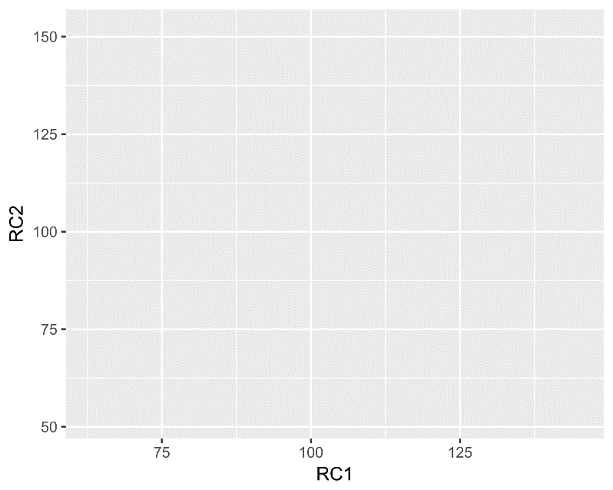
ggplot(data = d, mapping = aes(x = RC1, y = RC2))
We use data.frame d and tell which variables are onto which scales. Here, RC1 is on the x-axis, and RC2 is on the y-axis.
# Shorter code ggplot(d, aes(RC1, RC2))
But the plot is empty! Let’s add a new layer onto the plot using geom_point.

Slide 34
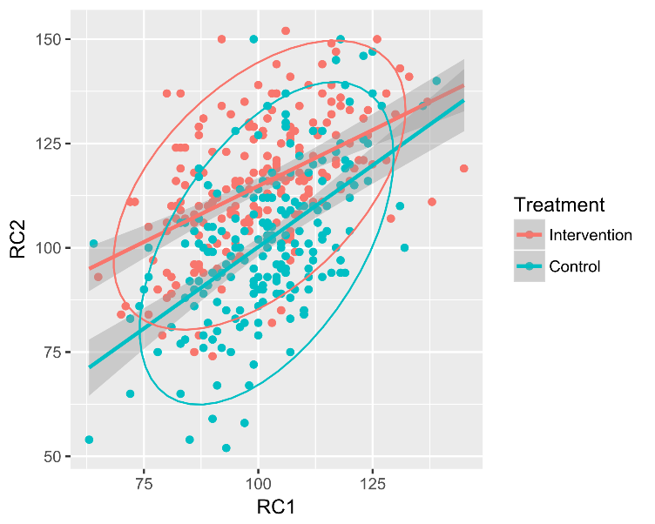
ggplot(d, aes(RC1, RC2, color = Treatment)) + geom_point() + geom_smooth(method = "lm", fullrange = TRUE) + stat_ellipse()
Nice!

Slide 35
Your Future in R
Code
Google
Code
Google
Code
Google
Google
Google
Google
Google
Ask me: schneider@temple.edu

Slide 36


Your Future in R
Code
Google
Code
Google
Code
Google
Google
Google
Google
Ask me: schneider@temple.edu
https://stackoverflow.com/
community.rstudio.com/
R Users Psychology Facebook Group
R for Data Science

